Slide 1

Snake Game
Group 14
BSc Management and Information Technology
Department of Industrial Management
Faculty of Science
University of Kelaniya
1

Slide 2
CONTENTS
1. Introduction of the game
2. Challengers & problems of the game
3. Plan to develop the game
4. Code
5. Our Team
2

Slide 3
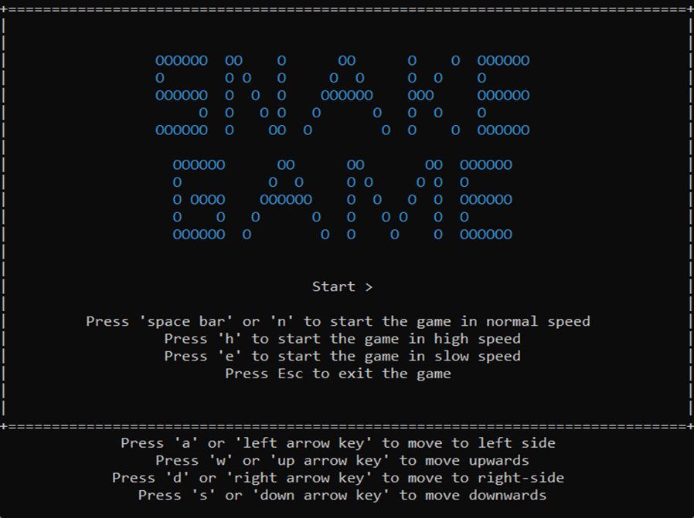


1. Introduction of the game
3

Slide 4
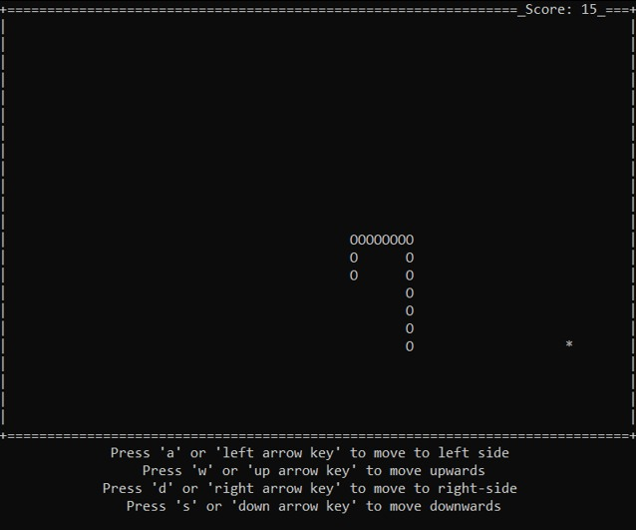


4

Slide 5
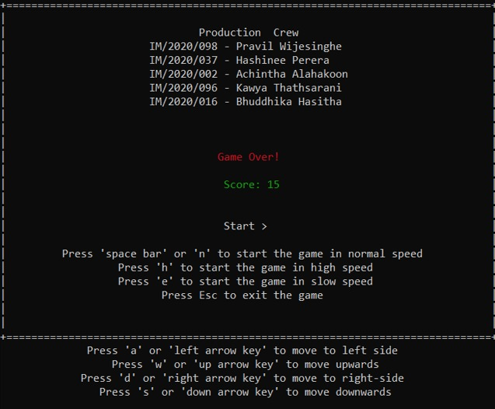

5

Slide 6
3. Challengers & problems of the game
Need more knowledge to add advanced features to the game
The game is supported only in the windows Operating system
Difficult to manage all functions performed by the snake game
Handling too many functions and variables
6

Slide 7
4. Plan to develop the game
Add a user-friendly interface for the game
Improve the multiplayer feature for the game using an
online platform
Used sound effects for every significant task
Used graphic effects to make the game more attractive
Develop as 3D Game
7

Slide 8
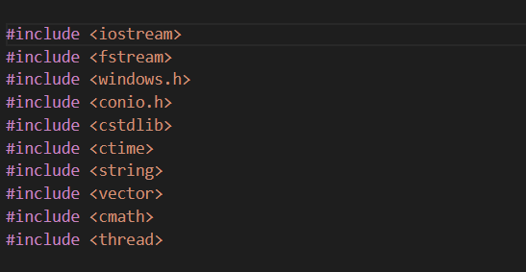

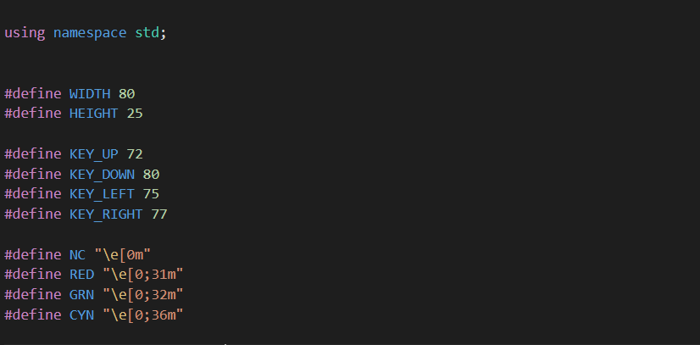
5. Code
8

Slide 9
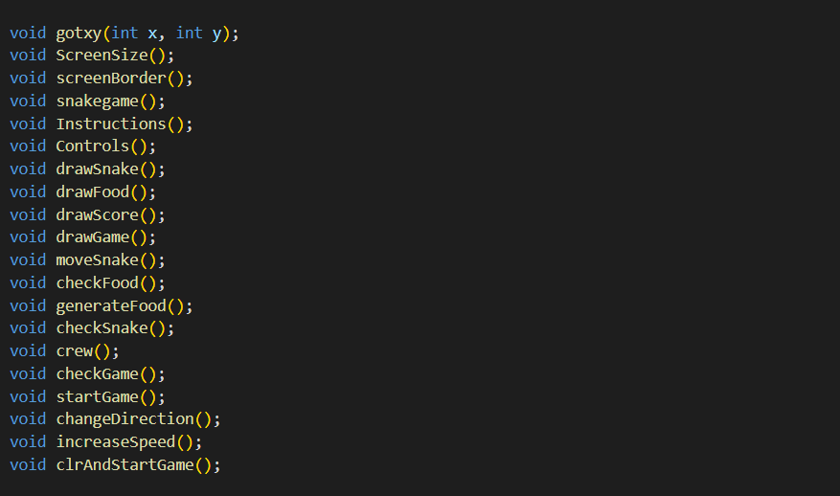

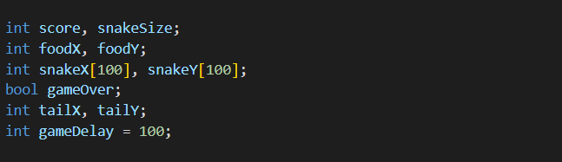
5. Code
//Functions that are used in the code
//Main global variables
9

Slide 10
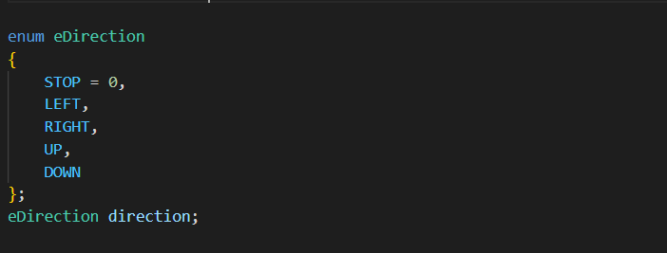
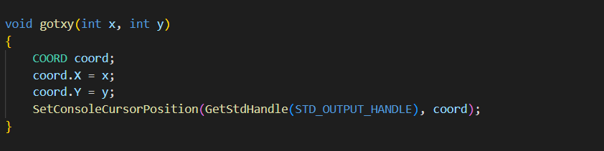
5. Code
10

Slide 11
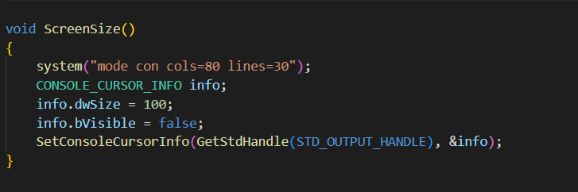
5. Code
//Set screen size and cursor visibility
11

Slide 12
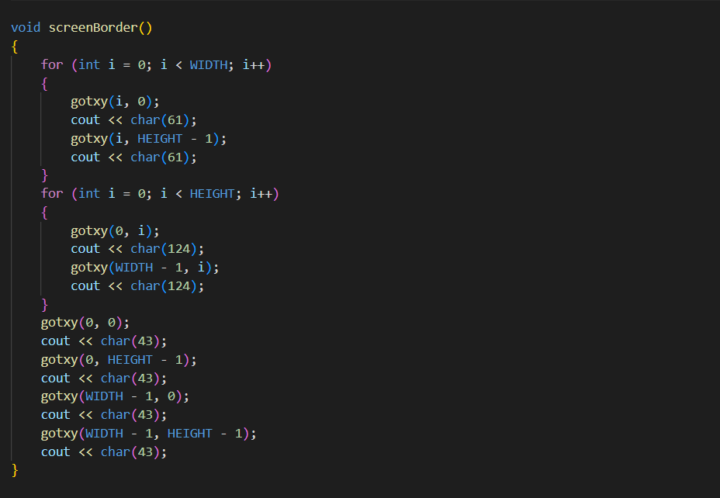
5. Code
12

Slide 13
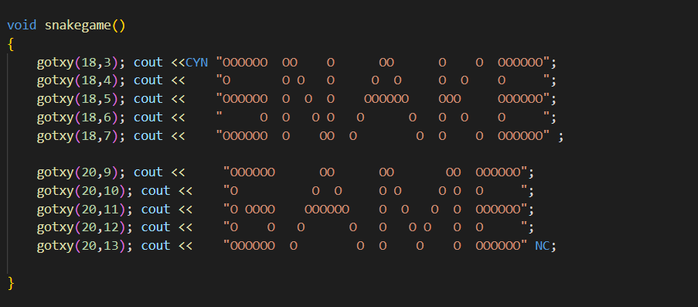
5. Code
13

Slide 14
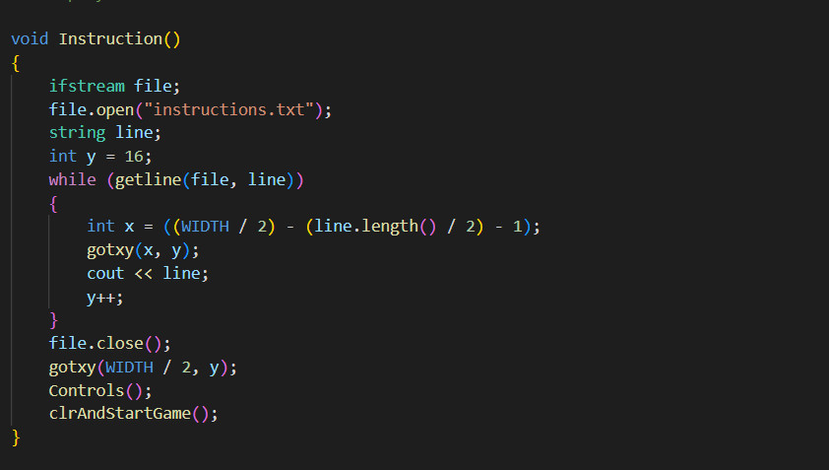
5. Code
14

Slide 15
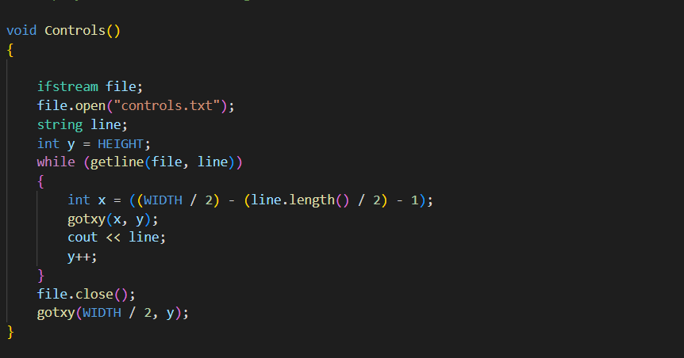
5. Code
15

Slide 16
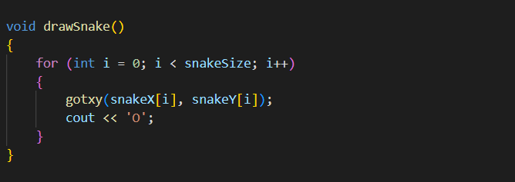
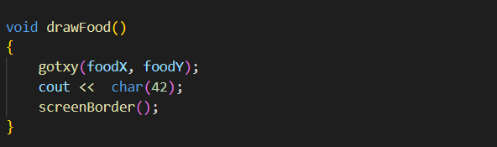
5. Code
16

Slide 17
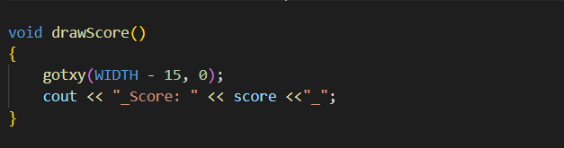
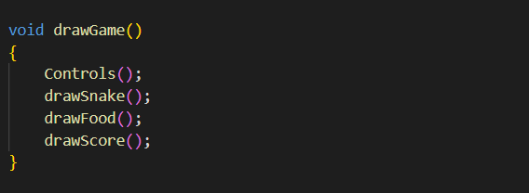
5. Code
17

Slide 18
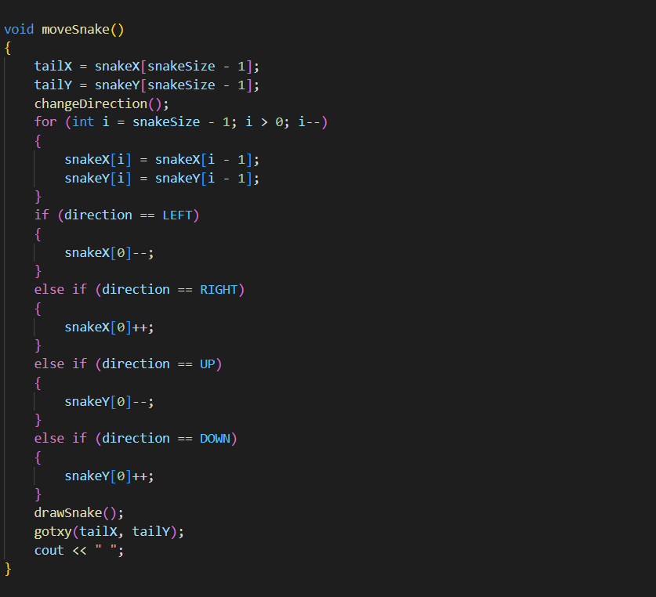
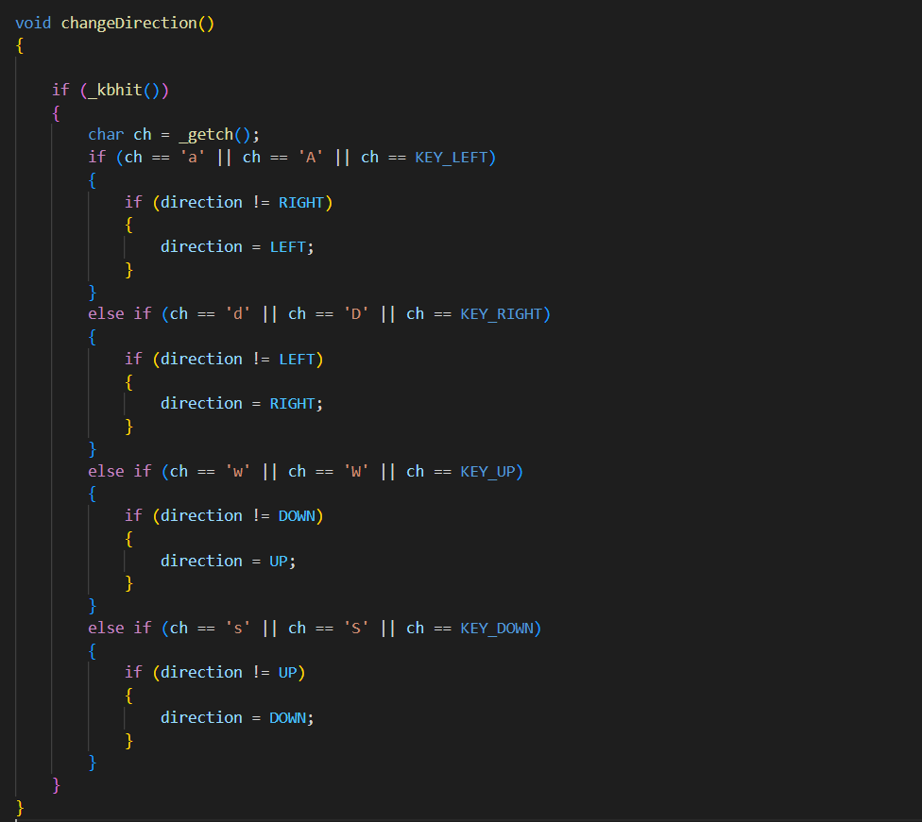
5. Code
18

Slide 19
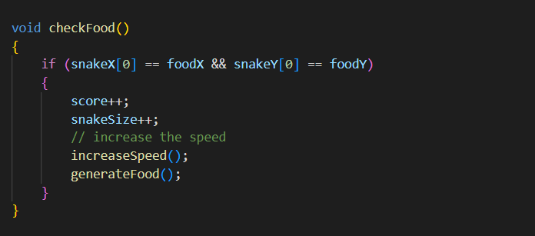
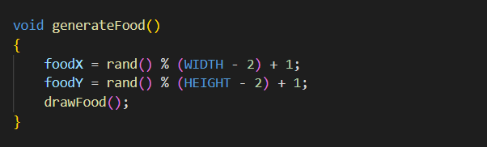
5. Code
19

Slide 20
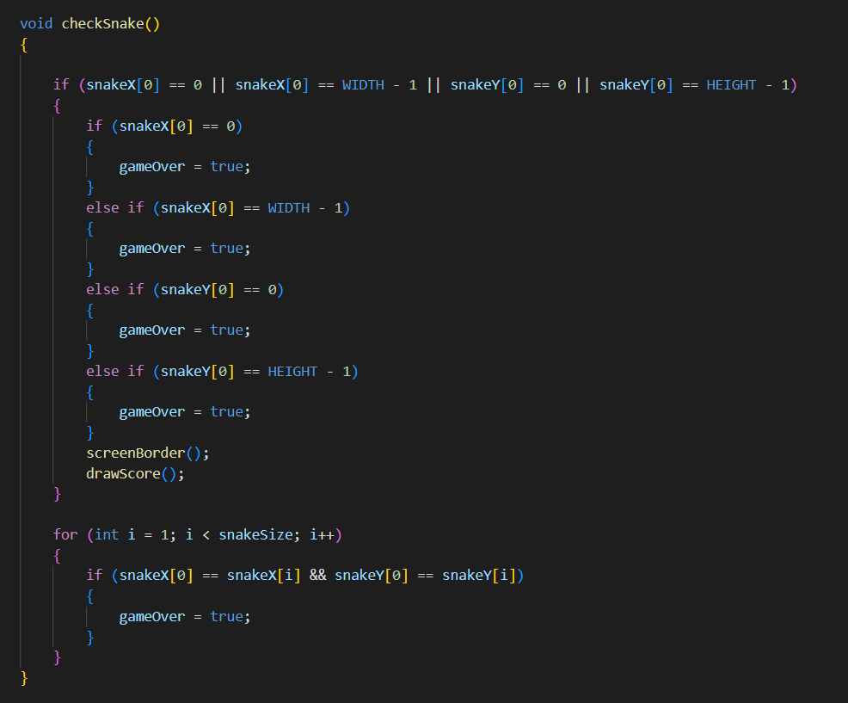
5. Code
20

Slide 21
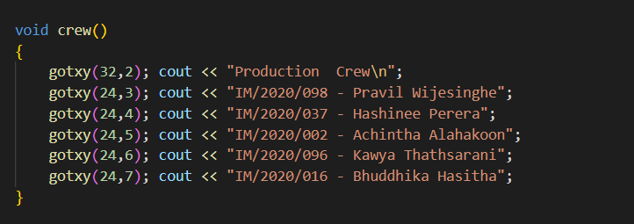
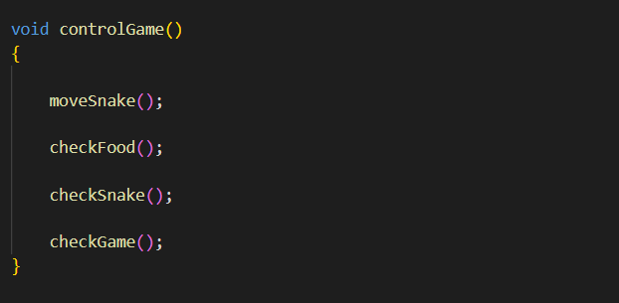
5. Code
21

Slide 22
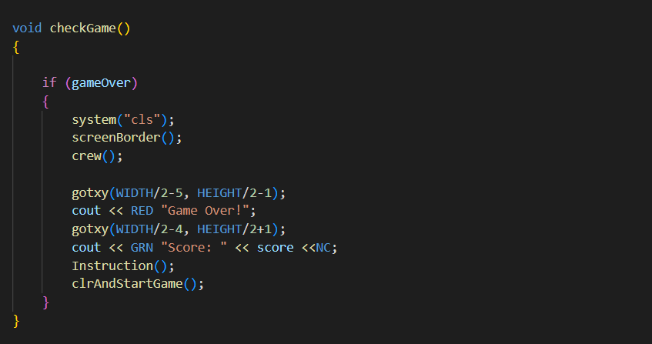
5. Code
22

Slide 23
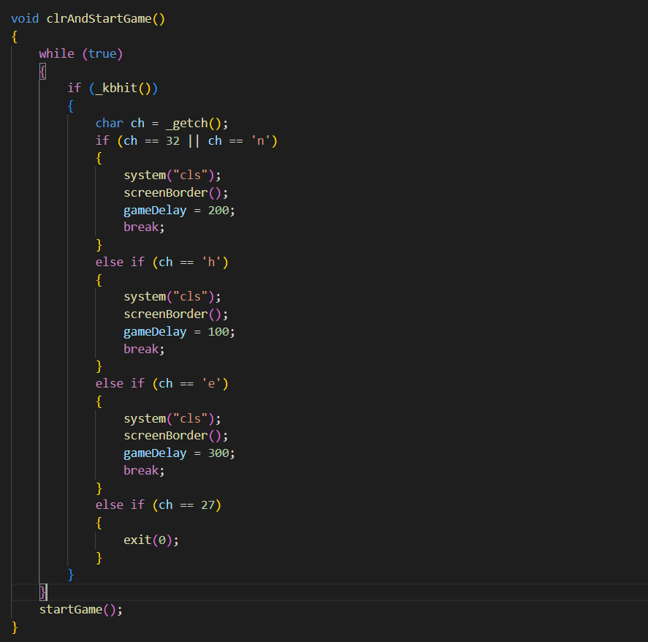
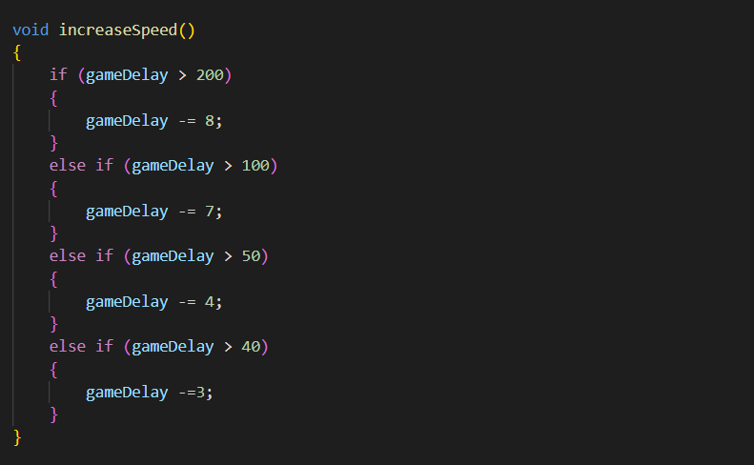
5. Code
23

Slide 24
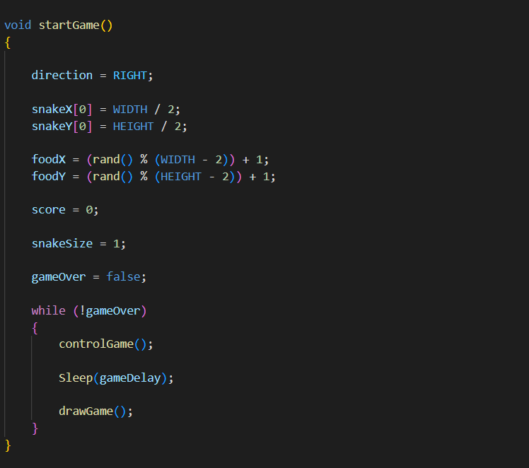
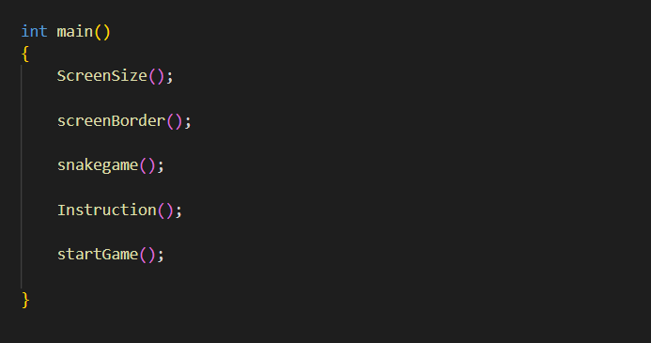
5. Code
24

Slide 25



6. Our Team
IM/2020/098 - Pravil Wijesinghe
IM/2020/037 – Hashinee Perera
IM/2020/002 - Achintha Alahakoon
IM/2020/096 - Kawya Thathsarani
IM/2020/016 - Bhuddhika Hasitha
25

Slide 26


THANK YOU!
DO YOU HAVE ANY QUESTIONS?
Please keep this slide for attribution.
26

